Slide 1


Scrum-Agile
Development

Slide 2
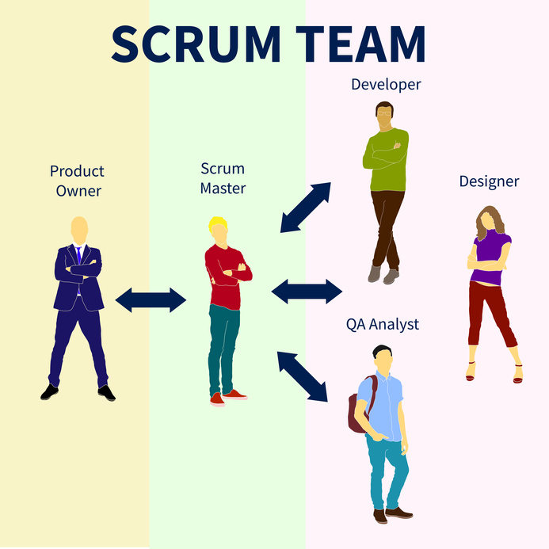
Agile Team Roles
Product Owner
Develop and communicate a product goal
Create, organize, and communicate backlog items
Scrum Master
Help coach and motivate team members
Remove barriers for the scrum team
Developers
Creating a sprint plan
Adapting their plan every day
Holding each other accountable

Slide 3

The Agile Software Development Lifecycle
Plan
Collect requirements
Work with stakeholders
Establish sprint plan
Design
Create a detailed design process
Define any restraints
Implementation
Begin development
Work through many small sprints
Testing
Test use cases and identify bugs
Release
Release product to market
Feedback and Maintenance
Implement feature updates
Patch bug fixes

Slide 4
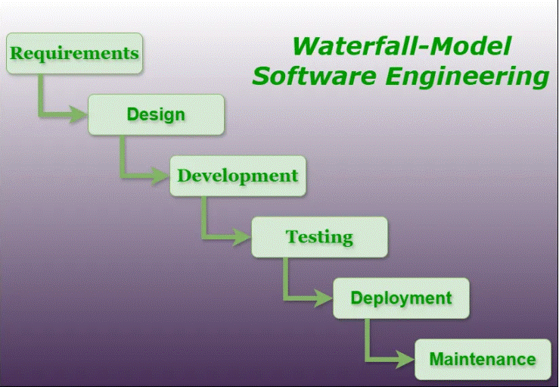
The Waterfall Model
Progress through the same stages as the agile model
Stages are sequential and has no error correction
Bugs and defects found very late in development
Example:
Developing an app for iOS and Android, however a bug is found that causes crashes on iOS. In the agile method, the bug is caught early and the app can be restructured to fix at little cost. In the waterfall method, the bug is caught late and the entire app needs to be recreated at high costs.

Slide 5
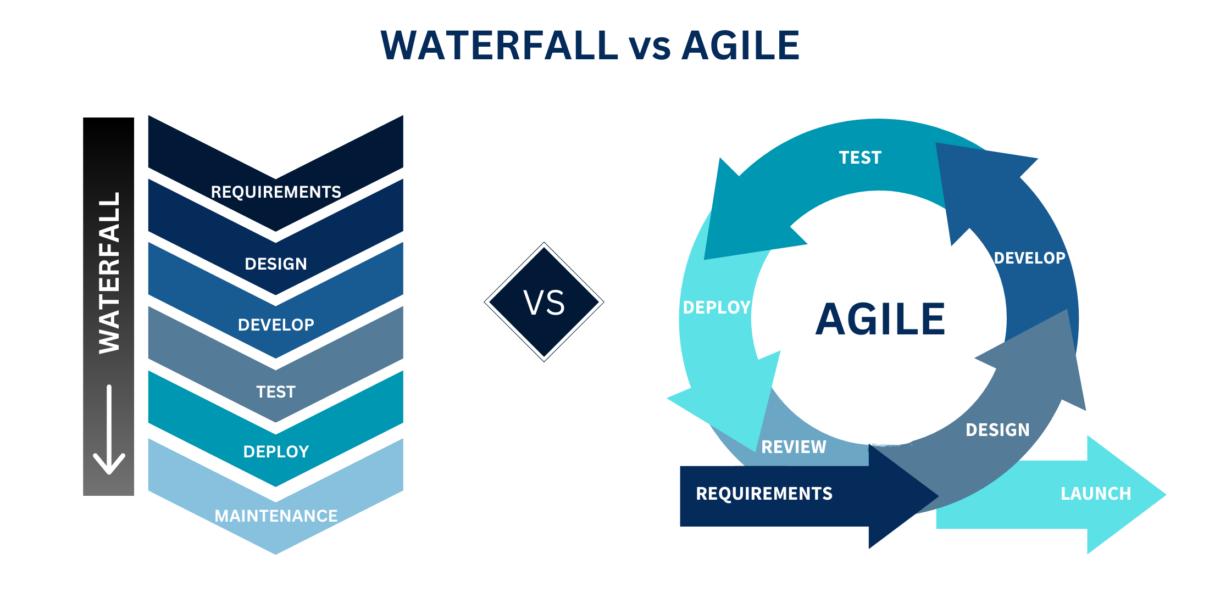
Waterfall vs. Agile Implementation
Waterfall
Agile
Strict requirement definitions
Rigid structure
One directional approach
Better for simple or static products
Loose requirements
High flexibility
Incremental approach
Better for constantly changing products

Slide 6
References
GeeksforGeeks. (2018, March 18). Waterfall Model - Software Engineering. GeeksforGeeks. https://www.geeksforgeeks.org/waterfall-model/
Iddo, D. (2019, October 4). Agile Development. Medium. https://medium.com/moodah-pos/agile-development-95cad3573abf
Scrum.org. (n.d.). What is a Scrum Master? Scrum.org. https://www.scrum.org/resources/what-is-a-scrum-master
Scrum.org. (2020). What is a Product Owner? Scrum.org. https://www.scrum.org/resources/what-is-a-product-owner
Transforming the Way we Work- Scrum, Waterfall or just Go “Agile” - Part I. (2023, June 6). Craft Silicon. https://www.craftsilicon.com/transforming-the-way-we-work-scrum-waterfall-or-just-go-agile-part1/
What is a Developer in Scrum? (n.d.). Scrum.org. https://www.scrum.org/resources/what-is-a-scrum-developer

